Slide 1

Data Warehouse
Presented by
FAISAL JAMIL

Slide 2
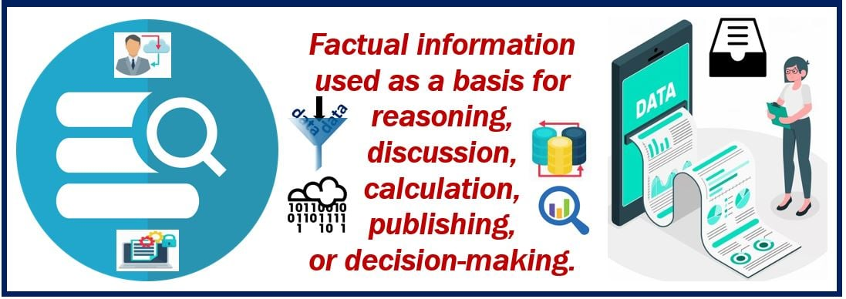
What does data mean?

Slide 3
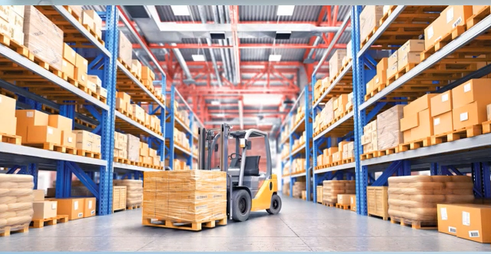
What is Warehouse?
A large building where the raw materials or manufactured goods are stored.

Slide 4



What is OLTP Systems?
Database system have been used traditionally for OLTP
Clerical data processing tasks
Detailed, up to date data
Structured repetitive tasks

Slide 5
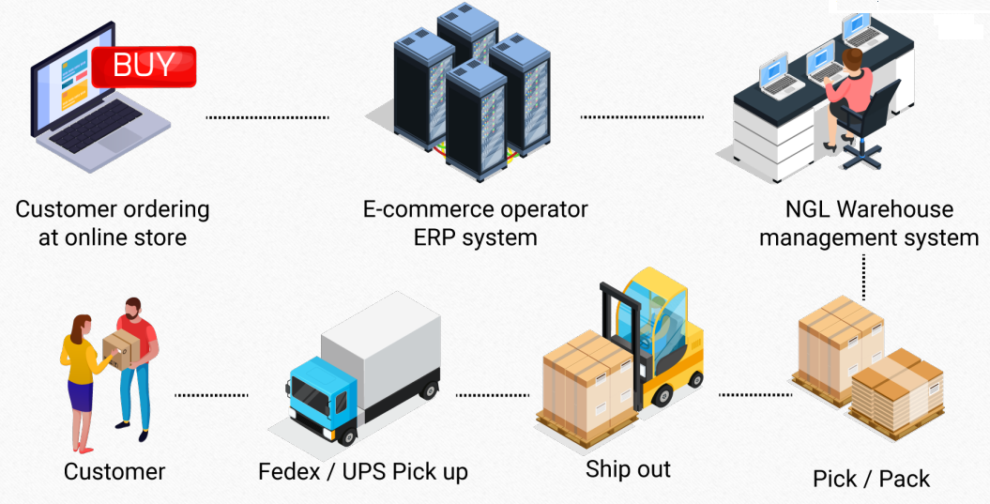
ERP Process Flow and OLTP Transactions data

Slide 6
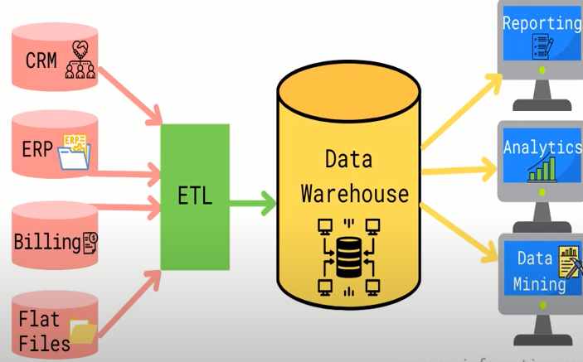
What is OLAP?
Data Warehouse
A decision support database that is maintained separately from the organization’s operational database.
Data warehouses are solely intended to perform queries and analysis and often contain large amounts of historical data
Connect and analyze business data from heterogeneous sources

Slide 7
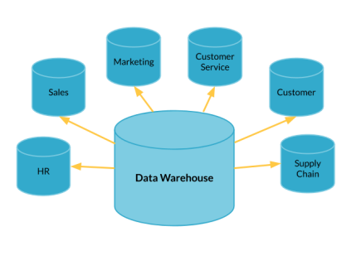
Father of Data Warehouse Bill Inmon
“A data warehouse is a subject-oriented, integrated, time-variant, and nonvolatile collection of data in support of management’s decision-making process.”

Slide 8
What is difference between OLTP vs OLAP?
 | OLTP | OLAP
Purpose | Support daily transactions | Report and analyze data
Design | Application-Oriented | Subject-Oriented
Data | Up-to-date, operational | Consolidated, historical
Queries | Simple transactions & frequent updates | Complex, aggregate queries & limited updates
Users | Thousands | Hundreds
Examples | 1. Find the price of a product 2. Update latest customer transaction | Calculate books with best profit margin Find most loyal customers

Slide 9
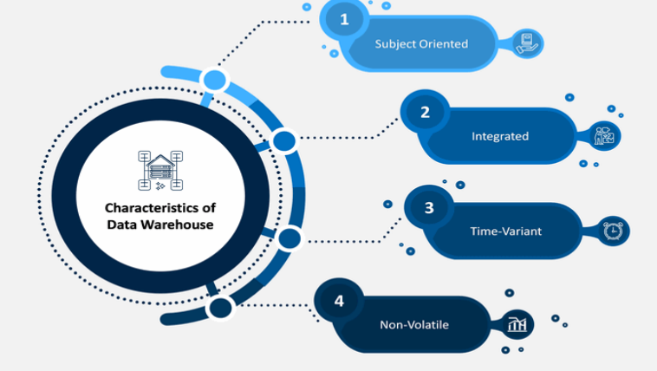
Features of Data Warehouse

Slide 10
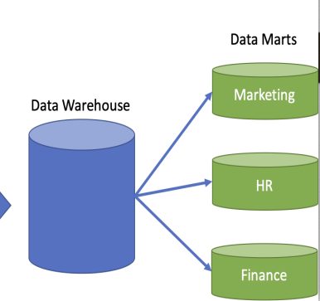
Features of Data Warehouse
Subject Oriented (Finance, Marketing, Inventory)
A data warehouse can be used to analyze a particular subject area. For example, "sales" can be a particular subject.

Slide 11
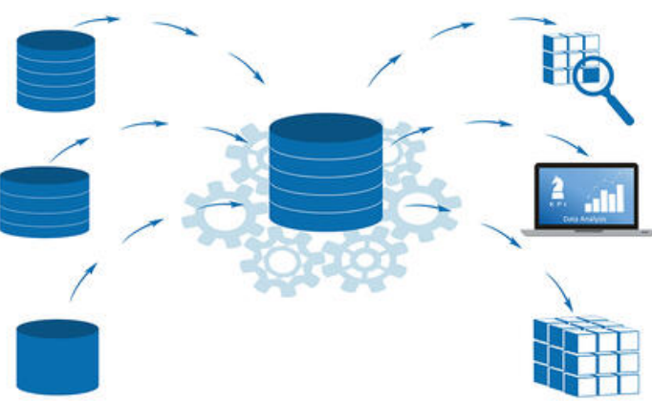
Features of Data Warehouse
Integrated
A data warehouse integrates data from multiple data sources. For example, source A and source B may have different ways of identifying a product, but in a data warehouse, there will be only a single way of identifying a product.

Slide 12
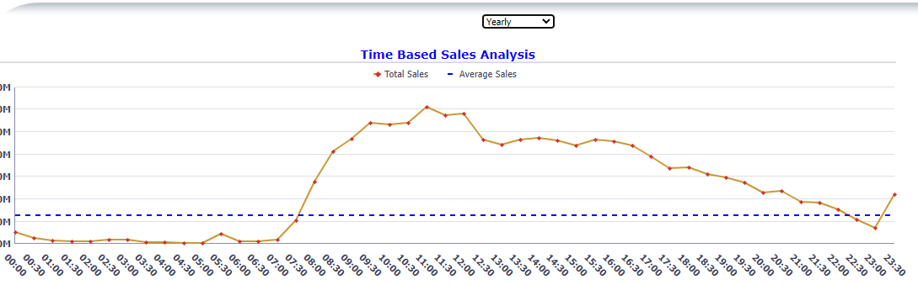
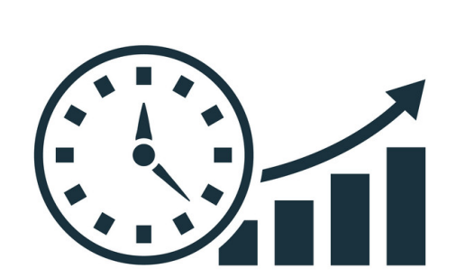
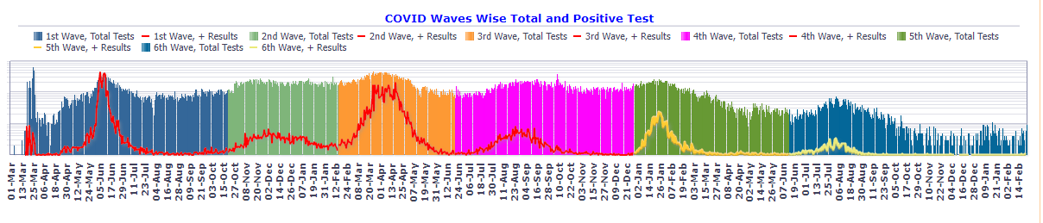
Features of Data Warehouse
Time Variant
Historical data is kept in a data warehouse. For example, one can retrieve data from 3 months, 6 months, 12 months, or even older data from a data warehouse. This contrasts with a transactions system, where often only the most recent data is kept. For example, a transaction system may hold the most recent address of a customer, where a data warehouse can hold all addresses associated with a customer.

Slide 13
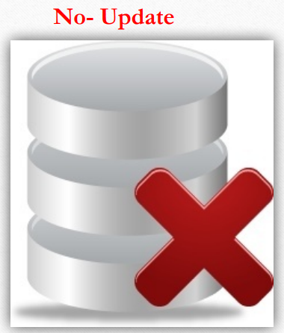
Features of Data Warehouse
Non-volatile
Once data is in the data warehouse, it will not change. So, historical data in a data warehouse should never be altered.

Slide 14
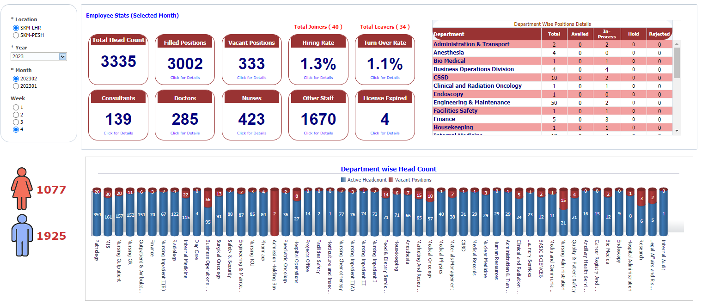
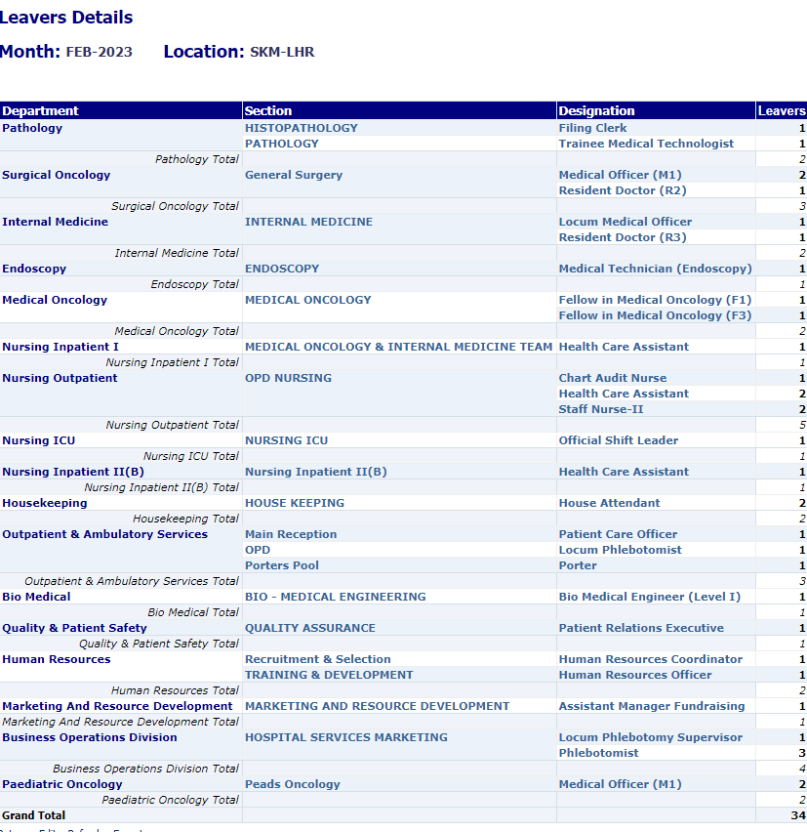
What is Granularity ?
Granularity refers to the level of detail of the data that is stored and managed.
Example. The HR manage want to see the turnover rate of Yearly, Quarterly ,monthly and weekly.

Slide 15
Data Models
What is Dimension?
A dimension table contains dimensions of a fact.
Examples (Time, Location, CPT, Patient etc.)
What is Fact?
The fact table contains measurements, metrics, and facts about a business process (Contain the foreign key of dimensions)

Slide 16
Data Modeling Schemas
Star Schema
The star schema in a data warehouse is historically one of the most straightforward designs. This schema follows some distinct design parameters, such as only permitting one central table and a handful of single-dimension tables joined to the table
Snowflake Schema
This data warehouse schema builds on the star schema by adding additional sub-dimension tables that relate to first-order dimension tables joined to the fact table.
Galaxy Schema
The Galaxy Data Warehouse Schema, also known as a Fact Constellation Schema, acts as the next iteration of the data warehouse schema. Unlike the Star Schema and Snowflake Schema, the Galaxy Schema uses multiple fact tables connected with shared normalized dimension tables.

Slide 17
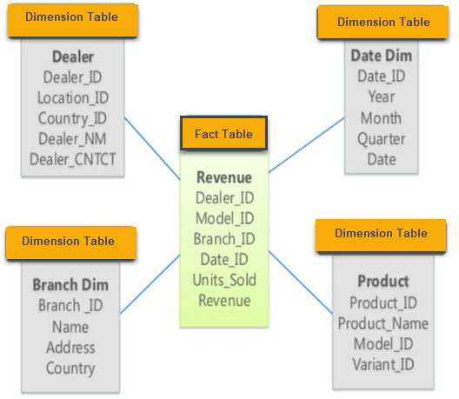
Star Schema

Slide 18
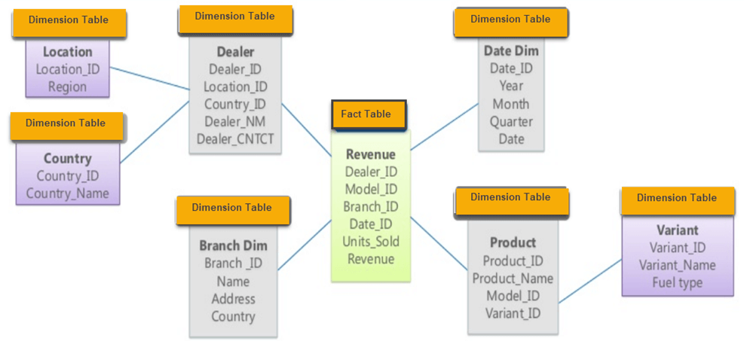
Snowflake Schema

Slide 19
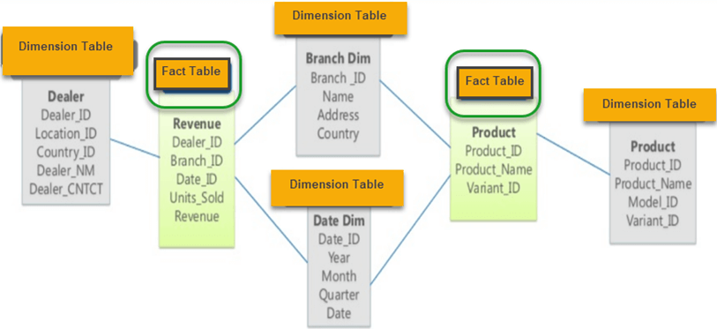
Galaxy Schema

Slide 20
Approach for Data Warehouse
Top Down
Bottom up

Slide 21
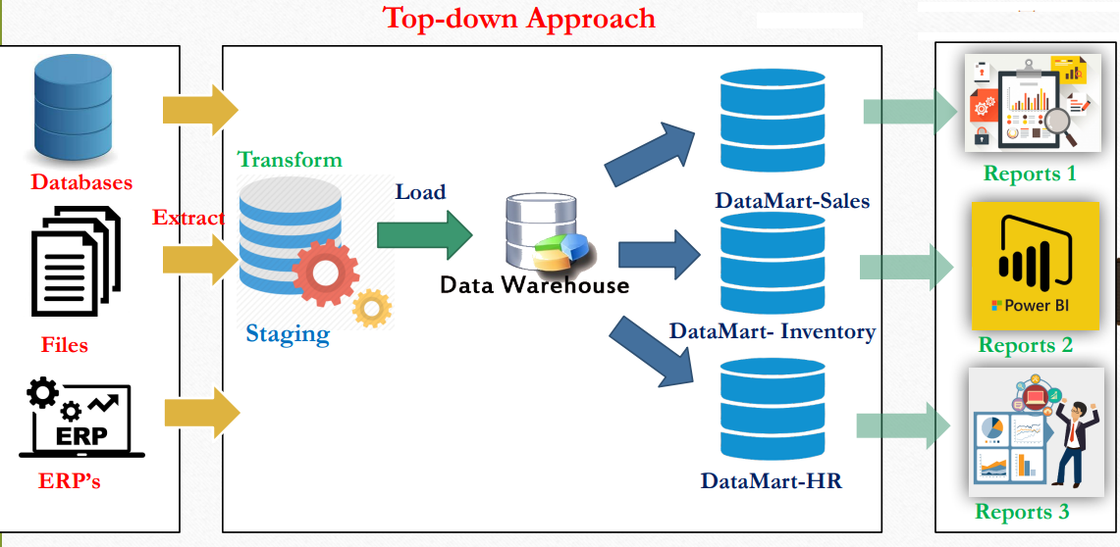
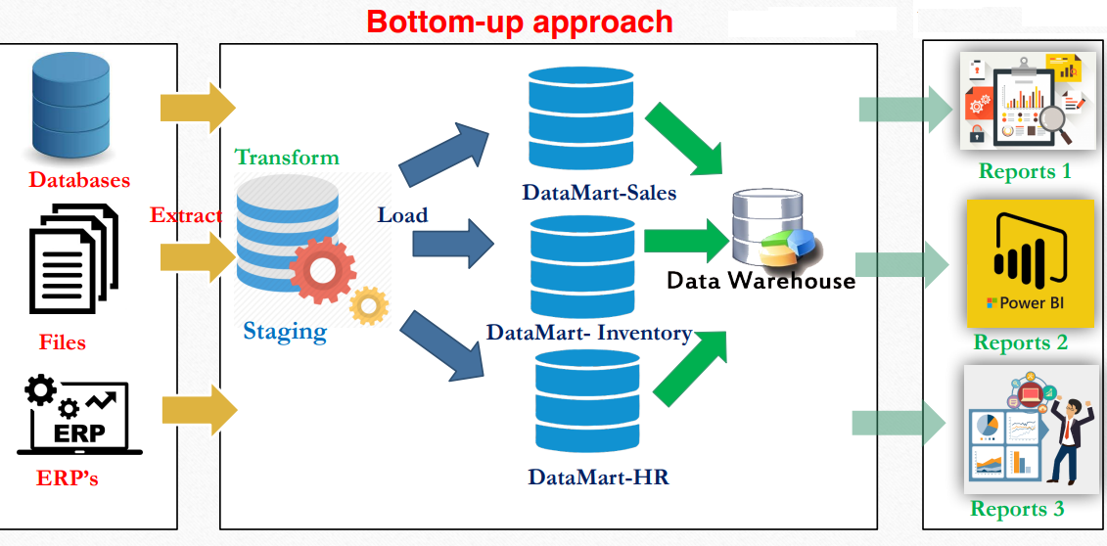
Top Down
Advantages of Top-Down Approach –
Since the data marts are created from the data warehouse, provides consistent dimensional view of data marts. 2. Creating data mart from data warehouse is easy.
Disadvantages of Top-Down Approach –
The cost, time taken in designing and its maintenance is very high.
Bottom Up
Advantages of Bottom-Up Approach –
As the data marts are created first, so the reports are quickly generated.
Also, the cost and time taken in designing this model is low comparatively.
Disadvantage of Bottom-Up Approach –
It is difficult to maintain

Slide 22
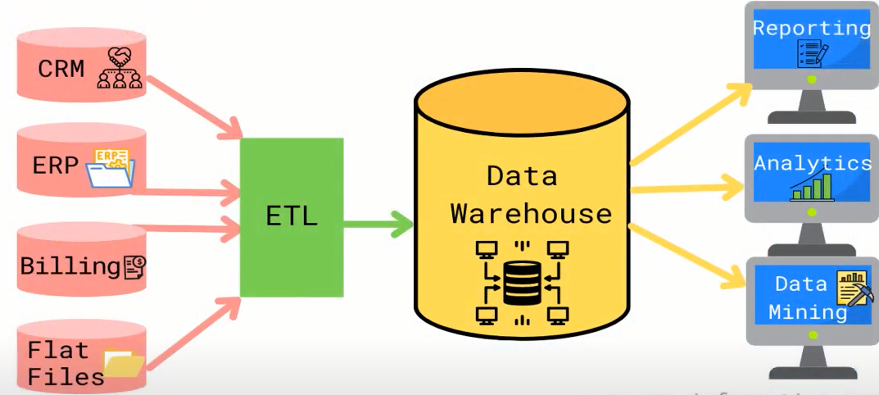
Stage of Data Warehouse
Collect | Store | Analyze | Consume

Slide 23
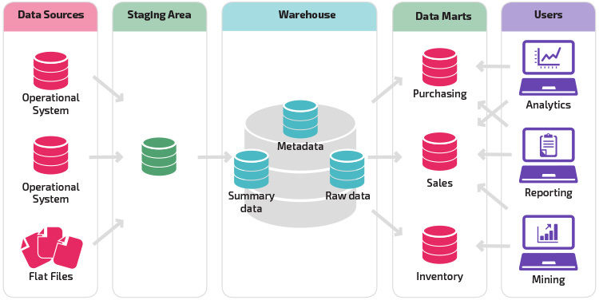
Architecture of Data Warehouse

Slide 24
What is Staging Area?
The Staging Area is a temporary storage area for data copied from Source Systems

Slide 25
What is ETL?
Extract
During data extraction, raw data is copied or exported from source locations to a staging area. Data management teams can extract data from a variety of data sources, which can be structured or unstructured.
Transform
Filtering, cleansing, de-duplicating, validating, and authenticating the data.
Formatting the data into tables or joined tables to match the schema of the target data warehouse.
Load
the transformed data is moved from the staging area into a target data warehouse.

Slide 26
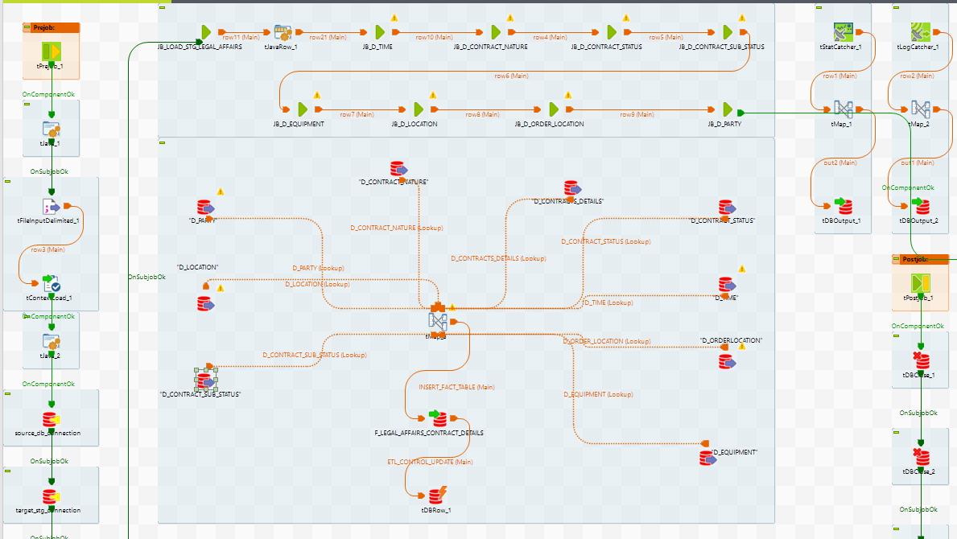
ETL Example

Slide 27
Data Warehouse Benefit in health care
Timely & Cost-effective Decisions
Improved Treatment Outcomes
Enhanced Patient Experience
Personalized & Improved Care Quality
Efficient Resource Management

Slide 28
